Slide 1

2.1.7 Two-dimensional vectors versus complex numbers

Slide 2
Introduction
In this topic, we will
  Observe the superficial relationship between 2-d vectors and complex numbers
  We will discuss the differences

Slide 3
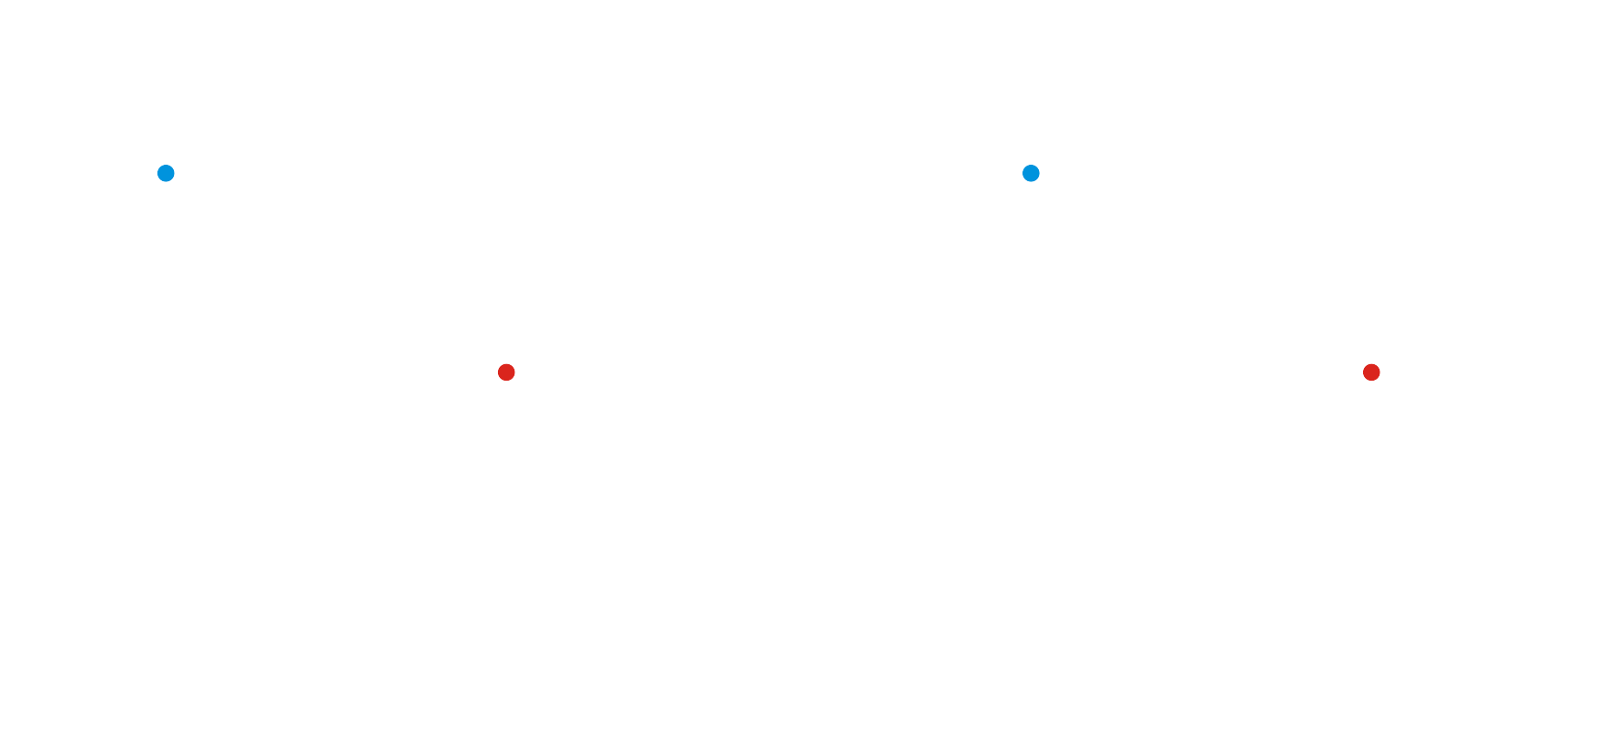
2-d vectors and complex numbers
We have described 2-dimensional vectors and complex numbers

Slide 4
2-d vectors and complex numbers
For a vector,
each entry represents a separate piece of information
A complex number is a single value,
no different than a real number
For a vector,
we will not be able to have a useful multiplication that works in R^{n}
Multiplication of complex numbers is well defined and has significance that is applicable

Slide 5
2-d vectors and complex numbers
For a vector,
there is no significance to the vector
For complex numbers,
the value 1 is that value such that 1z = z for all z and
every non-zero z has a reciprocal such that zz^{–1} = 1
Recall that represents a point on the plane,
yet, there is no significant relationship between this value and

Slide 6
2-d vectors and complex numbers
The question is: what are we modeling
  There are only limited numbers of applications of complex numbers
    Finding solutions to differential equations
    Simulating sinusoidal functions with equal periods
      Specifically, alternating current
    Quantum mechanics
  2-dimensional vectors are more ubiquitous

Slide 7
Historical comment
Prior to vectors becoming a topic of study in their own right,
  William Rowan Hamilton introduced quaternions,
  which had four components α + β i + γ j + δ k
  Unfortunately, it is not commutative…
  There is an eight-component number system, the octonians,
  but for them, multiplication is not even associative
One cannot create such systems where multiplication is reasonably well defined (e.g., existence of reciprocals) for anything other than powers of two…

Slide 8
Summary
Following this topic, you now
  Understand that 2-dimensional vectors and complex numbers represent separate ideas
  Are aware that the first has two components,
  while the second is a single value
  Understand that for vectors, there is no significance to the reciprocals to their corresponding complex value

Slide 9
References
[1] https://en.wikipedia.org/wiki/Complex_number

Slide 10
Acknowledgments
None so far.

Slide 11



Colophon
These slides were prepared using the Cambria typeface. Mathematical equations use Times New Roman, and source code is presented using Consolas.
The photographs of flowers and a monarch butter appearing on the title slide and accenting the top of each other slide were taken at the Royal Botanical Gardens in October of 2017 by Douglas Wilhelm Harder. Please see
https://www.rbg.ca/
for more information.

Slide 12
Disclaimer
These slides are provided for the ne 112 Linear algebra for nanotechnology engineering course taught at the University of Waterloo. The material in it reflects the authors’ best judgment in light of the information available to them at the time of preparation. Any reliance on these course slides by any party for any other purpose are the responsibility of such parties. The authors accept no responsibility for damages, if any, suffered by any party as a result of decisions made or actions based on these course slides for any other purpose than that for which it was intended.

